Slide 1
Measure of metrics – II Pagerank and HITS
MA 653: Network Science
Instructor: Ashok Singh Sairam
ashok@iitg.ac.in

Slide 2
Recap
E
A
In directed acyclic graphs: some in-degrees are zero
Eigenvector centrality is 0
Fix: Katz centrality used a “free” weight of β(=1)
Problem with Katz centrality
Compare the weights of D with that of E, F and G
D
B
F
C
G
These nodes gets a high Katz centrality weight by virtue that they are
pointed to by a node with large weight
Pagerank and HITS algorithm address the issue with Katz centrality

Slide 3
Background (1)
Early search engines mainly compared content similarity of the query and the indexed pages. i.e.,
They use information retrieval methods, cosine similarity, TF-IDF, ...
In the mid 1990’s, it became clear that content similarity alone was no longer sufficient.
The number of pages grew rapidly in the mid 1990’s.
How to choose only 30-40 pages and rank them suitably to present to the user?
Content similarity is easily spammed.
Webpage can repeat words and add related words to boost the rankings of his pages and/or to make the pages relevant to a large number of queries.

Slide 4
Background (2)
Web pages are connected through hyperlinks, which carry important information
During late 1990s, two influential search algorithms were proposed that exploited the hyperlinks to rank pages according to their levels of “prestige” or “authority”
PageRank
Sergey Brin and Larry Page, PhD students from Stanford University
Emerged as the dominant link analysis model due to its query-independence, ability to combat spamming, and Google’s huge business success.
HITS (Hyperlink-Induced Topic Search)
Prof. Jon Kleinberg (Cornell University)
Part of the Ask search engine (www.Ask.com).

Slide 5
Pagerank: Intuitive idea
Philosophy: A webpage is important if it is pointed to by other important pages
PageRank interprets a hyperlink from page i to page j as a vote, by page i, for page j.
PageRank also looks at the page that casts the vote.
A vote casted by an “important” page i weighs more heavily and helps to make page j more "important" (like eigenvector and Katz)
Also, the vote of page i is shared among the pages that it points to, so page j gets a fraction of the vote

Slide 6
PageRank
One possible problem with Katz centrality is that a vertex v with high centrality and high out-degree will cause a large number of vertices to have high centrality as well
In reality, though each one of the vertices that v points to should get a fraction of v’s centrality
A problem can arise when a node j has no vertices that it points to
A_{ij} as well as j’s out-degree will be 0 and their ratio is not defined
However, when a node has no out edges should contribute zero to the centralities of any other vertex and hence we can artificially set this contribution to 0 by setting its out-degree to 1

Slide 7
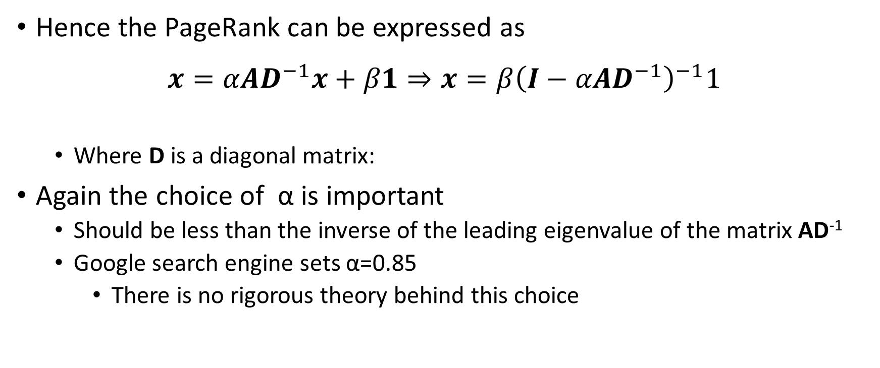
PageRank
Hence the PageRank can be expressed as
$$x=αAD^{−1}x+β1⇒x=β{\left(I−αAD^{−1}\right)}^{−1}1$$
Where D is a diagonal matrix:
Again the choice of α is important
Should be less than the inverse of the leading eigenvalue of the matrix AD⁻¹
Google search engine sets α=0.85
There is no rigorous theory behind this choice

Slide 8

Ex: Pagerank
Compute pagerank of each node
Problem vertex
(no outgoing links)
in-degree matrix

Slide 9
PageRank
Again we can generalize PageRank
β_{i} can be possibly based on the relevance of the page/vertex with the query
With no additive constant term we get:
For an undirected network this is simply the degree centrality
For directed networks it does not reduce to a known centrality measure, but it suffers from the same problem of the original eigenvector centrality

Slide 10
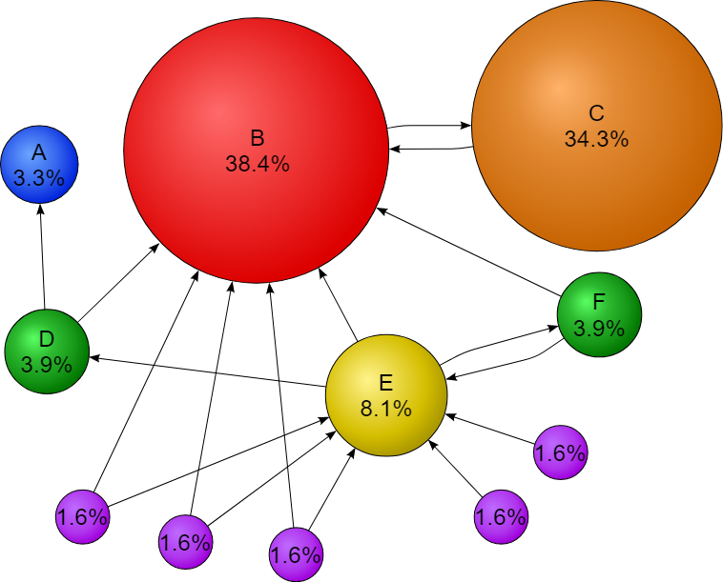
How it looks?
No node has 0 page rank

Slide 11
Hubs and Authorities
So far we have accorded a node high centrality if it is pointed to by others with high centrality.
However, in some networks, we may accord a node high centrality if it points to others with high centrality
Ex: Reviews do not contain much information about the subject but tell us where we will get the information, which makes them useful
Thus, there are two types of important nodes in directed networks
Authorities are nodes that contain useful information on a topic of interest
Hubs are nodes that tell us where the best authorities can be found
The concept of Hubs and Authorities was first put forward by Klienberg and developed into a centrality algorithm called HITS
The HITS algorithm gives each vertex i in a network an authority centrality xi and a hub centrality yi . The defining characteristic of a vertex with high authority centrality is that it is pointed to by many hubs, i.e., by many other vertices with high hub centrality. And the defining characteristic of a vertex with high hub centrality is that it points to many vertices with high authority centrality.
Thus an important scientific paper (in the authority sense) would be one cited in many important reviews (in the hub sense). An important review is one that cites many important papers

Slide 12
Hyperlink-Induced Topic Search (HITS)
HITS defines two types of centralities for a vertex i
Authority centrality x_{i}
Pointed to by nodes with high hub centrality
Hub centrality y_{i}
Points to nodes with high authority centrality
y₁
y₂
y_{l}
H
H
H
y_{i}
H
A
A
A
A
x_{i}
x₁
x₂
x_{k}

Slide 13
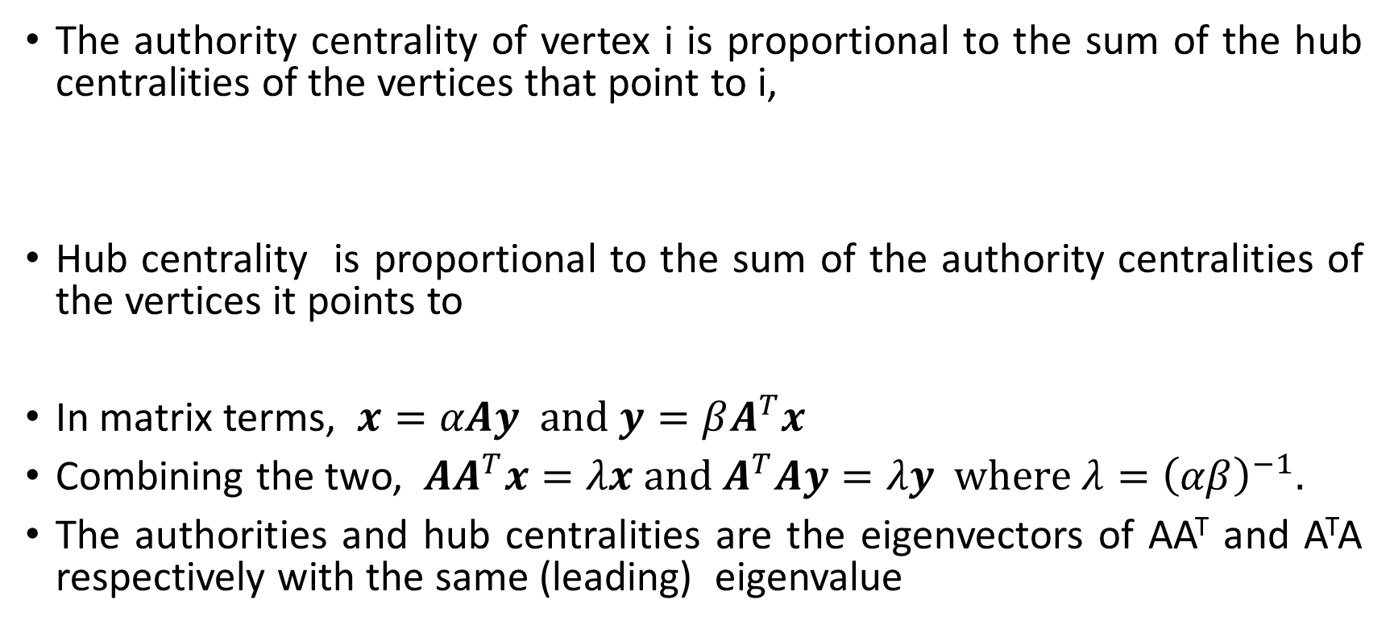
HITS
The authority centrality of vertex i is proportional to the sum of the hub centralities of the vertices that point to i,
Hub centrality is proportional to the sum of the authority centralities of the vertices it points to
In matrix terms, $x=αAy \text{and} y=βA^{T}x$
Combining the two, $AA^{T}x=λx \text{and} A^{T}Ay=λy \text{where} λ={\left(αβ\right)}^{−1}.$
The authorities and hub centralities are the eigenvectors of AA^{T} and A^{T}A respectively with the same (leading) eigenvalue

Slide 14
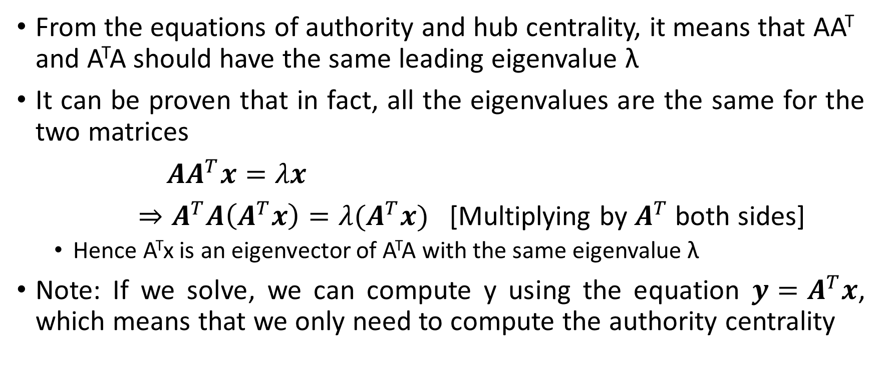
HITS
From the equations of authority and hub centrality, it means that AA^{T} and A^{T}A should have the same leading eigenvalue λ
It can be proven that in fact, all the eigenvalues are the same for the two matrices
${AA}^{T}x=λx$
$⇒A^{T}A\left(A^{T}x\right)=λ(A^{T}x)$ [Multiplying by $A^{T}$ both sides]
Hence A^{T}x is an eigenvector of A^{T}A with the same eigenvalue λ
Note: If we solve, we can compute y using the equation $y=A^{T}x$, which means that we only need to compute the authority centrality

Slide 15
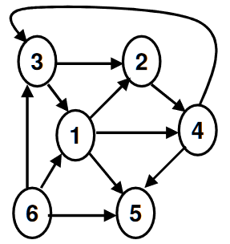
What does AA^{T} represent? => Co-citation Coupling
Compute the AA^{T} of the graph?
 | 1 | 2 | 3 | 4 | 5 | 6
1 | 2 | 1 | 1 | 0 | 1 | 0
2 | 1 | 2 | 0 | 1 | 1 | 0
3 | 1 | 0 | 2 | 0 | 2 | 0
4 | 0 | 1 | 0 | 2 | 1 | 0
5 | 1 | 1 | 2 | 1 | 3 | 0
6 | 0 | 0 | 0 | 0 | 0 | 0

Slide 16
What does A^{T}A represent? => Bibliographic Coupling
Compute the A^{T}A of the graph?
 | 1 | 2 | 3 | 4 | 5 | 6
1 | 3 | 1 | 1 | 1 | 0 | 1
2 | 1 | 1 | 0 | 0 | 0 | 0
3 | 1 | 0 | 2 | 0 | 0 | 1
4 | 1 | 0 | 0 | 2 | 0 | 2
5 | 0 | 0 | 0 | 0 | 0 | 0
6 | 1 | 0 | 1 | 2 | 0 | 3

Slide 17
Bibliographic Coupling
Two papers i and j are related if they refer to one or more papers k in common.
The number of common references is an indicator of the similarity between the two papers.
However, the similarity is based on the opinion of only the authors of the two papers;
It is a static measure: established when a paper gets published and not updated henceforth.
Hence, it cannot be used to trace the evolution of an academic field.
Strength: Unlike Co-citation coupling, there is no need to wait for other papers to cite.

Slide 18
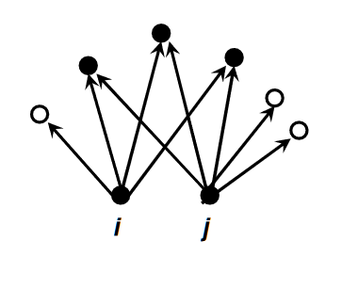
Ex: Bibliographic coupling
Bibliographic coupling B_{ij} = 1 iff A_{ki} = 1 and A_{kj} = 1.
That is B = A^{T}A

Slide 19
Notes on HITS
AA^{T} is the co-citation matrix → authority centrality is roughly the eigenvector centrality of the co-citation matrix
Why roughly?
Similarly A^{T}A is the bibliographic coupling matrix → hub centrality is roughly the eigenvector centrality of the bibliographic coupling network
HITS provides an elegant solution to the problem raised from eigenvector centrality in directed networks

Slide 20
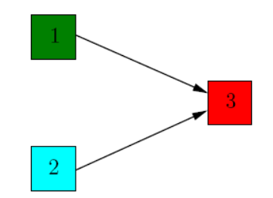
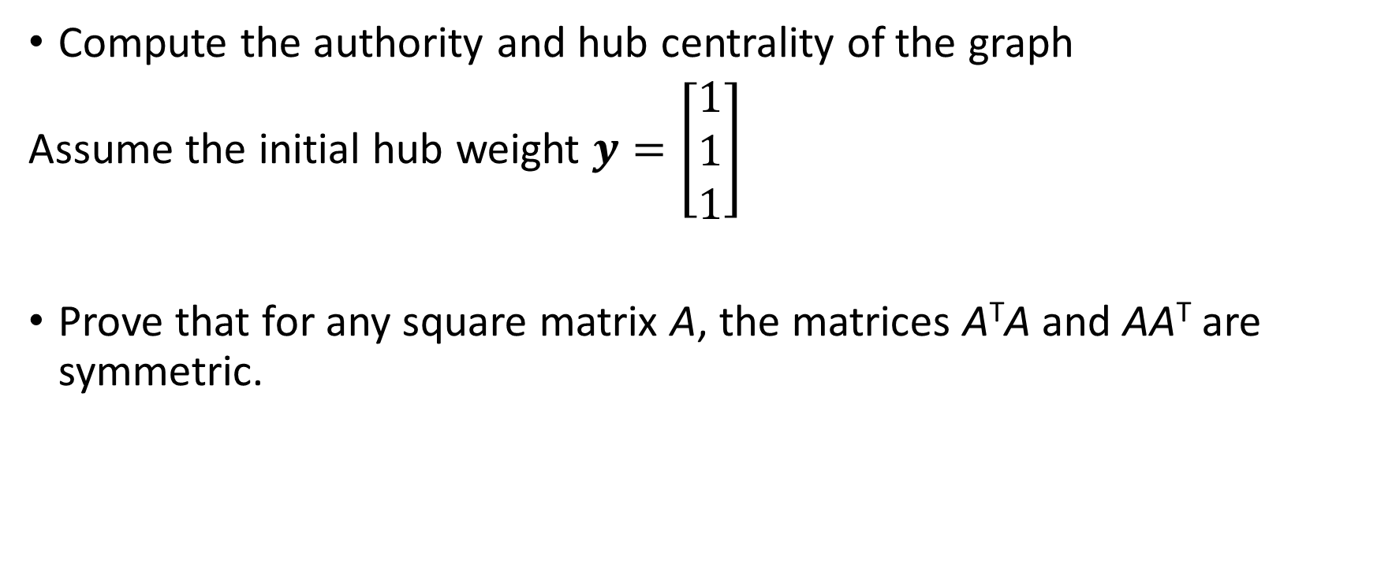
Review
Compute the authority and hub centrality of the graph
Assume the initial hub weight $y=\left[\begin{matrix}1 \\ 1 \\ 1\end{matrix}\right]$
Prove that for any square matrix A, the matrices A^{T}A and AA^{T} are symmetric.

